Slide 1
Robust Adversarial Image Detection in Classification
Arti Jain, Grant Ovsepyan, Nithanth Ram

Slide 2
Problem Statement
Adversarial attacks on machine learning models can have catastrophic effects
Ex. Autonomous vehicle system trying to perform traffic sign classification
White-box attacks (access to model’s gradients) and black-box attacks (no access to model)
Investigate various conditioning techniques to explore the possibility of strengthening classification at inference time against white-box and black-box image perturbations
Notes:
As we’ve learned in a previous homework assignment, adversarial attacks on ML models can easily cause misclassifications by the model. There are many scenarios where this can be catastrophic, for example during traffic sign classification. Obviously, if a car misclassified a traffic sign, this would lead to the way taking the wrong action or inaction.
Our project originally started as a way to uncover the manipulations in adversarial images but then transitioned into running experiments of trying our various conditioning techniques to explore if it’s possible to strengthen classification at inference time.
Since there are many different types of attacks, we focused on the exploration of a black box evasion attack where the attack has no access to the model’s parameters and the data is manipulated during deployment.
Nithu

Slide 3
Previous Work
Color and Edge-Aware Adversarial Image Perturbations [1]
New easy-to-compute subtle perturbations involving regions of smoothness and color contrast
Adversarial Training for Free! [3]
Add semi-supervised virtual adversarial noise to the input during training, acting as a regularizer
n-ML: Mitigating Adversarial Examples via Ensembles of Topologically Manipulated Classifiers [2]
Train multiple topologies so that ensembling these networks together provides more defense against adversarial examples
Notes:
Nithu

Slide 4
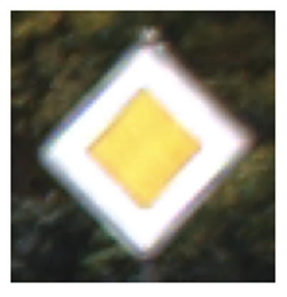
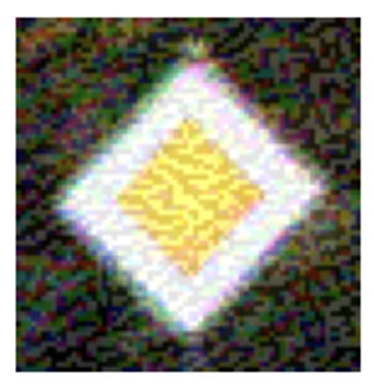
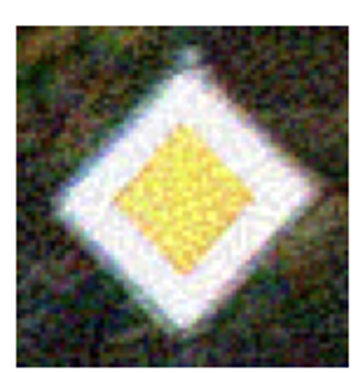
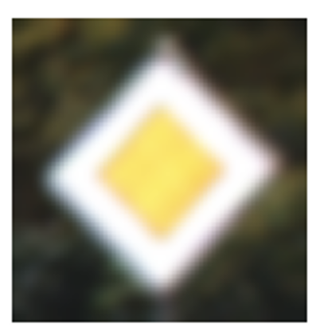
Dataset
Original Image
Dataset: GTSRB (German Traffic Sign Recognition Benchmark)
43 classes (speed limit, stop sign, pedestrian crossing, etc.)
39,210 training images
FGSM
PGD
White Box Attacks
FGSM (Fast Gradient Sign Method)
Fast and efficient method to generate attack
PGD (Projected Gradient Descent)
Worst case boundaries of the model performance
Black Box Attack:
Gaussian Blur
mimics real world scenario -> out of focus images
Gaussian Blur

Slide 5

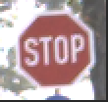
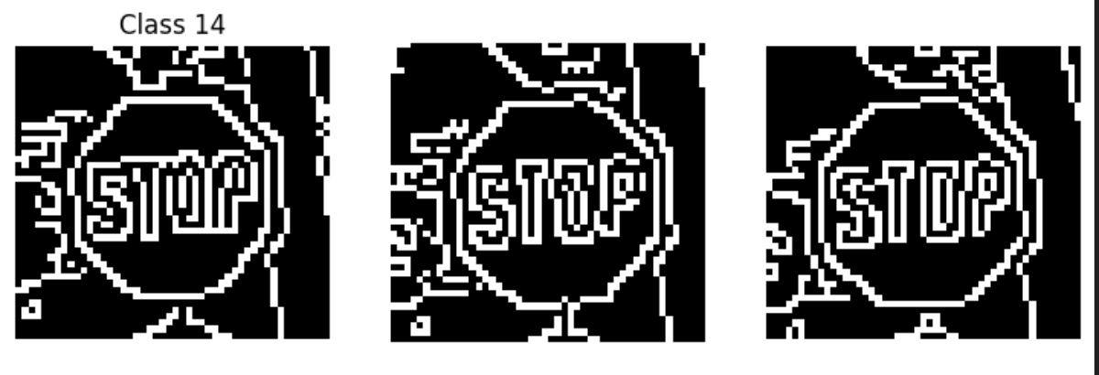
Our Approach
Our approach was to experiment with image manipulation techniques to observe the change in misclassification from a perturbed dataset
Some of these processing techniques included utilizing canny edge maps, depth maps, contrast/light enhancement, de-blurring, de-noising
We tried 3 methods:
Concatenating canny edge maps to the input data and then passing it through our trained model
Using different image processing techniques on the perturbed data and then running inference
Ensembling separate classifiers/sub-neural networks
Notes:
Use the low-level features of images to help our model classify the perturbed images correctly?
Use Canny edge detection to extract edges of images and use this additional input to try and mitigate classification errors due to attacks because the edge detection should not be affected by the perturbation as the high level features
Solution:
Concatenate the canny image to the original input before passing it to the model as a way of conditioning input on canny edges
MPRNet:
Ensembling separate classifiers/sub-neural networks - one for edged image, one for normal input

Slide 6
Experiment Framework
Fine-tune existing pre-trained image classifier models on traffic sign dataset
Perform adversarial perturbations to dataset and measure degradation of model efficacy
Tried mitigation technique
Concatenating Canny Edge image to original image
Unblurring/denoising image (MPRNet), contrast enhancement, K-means clustering, based on the color similarity
Ensembling and stacking models to get more robust classification
Use F1-score and accuracy to track the performance across experiments

Slide 7
Training
Base Models: ResNet50, InceptionNetV3, MobileNetV3
ResNet50 fine-tuned ~ 76% test accuracy, 0.73 test F1-score
InceptionV3 fine-tuned ~ 68% test accuracy, 0.70 test F1-score
MobileNetV3 fine-tuned ~ 99.3% test accuracy, 0.99 F1-score
Proceeding with MobileNetV3 as baseline fine-tuned model
Apply adversarial perturbations with fixed parameters for control
Gaussian Blur: kernel_size=5, sigma=2 ( severe blur from visual inspection)
FGSM attack epsilon = 0.1, (1 iteration) (significant noise perturbation, additional noise would perturn image too much)
PGD attack epsilon = 0.1, alpha= 0.04, num_iteration = 10 (less noise perturbation than FGSM, noise density between original unperturbed image and FGSM image)
Decided to manually sort the classes for further inference using most readable images taken under reasonable light conditions
Selected classes are: 0,1,2,11,12,14,16,28,34,35,39 (3810 images)
Baseline test accuracies on the adversarial images using MobileNetV3 on the selected classes are
Gaussian Blur: 89.61%
FGSM attack: 67.14%
PGD attack: 77.27%

Slide 8
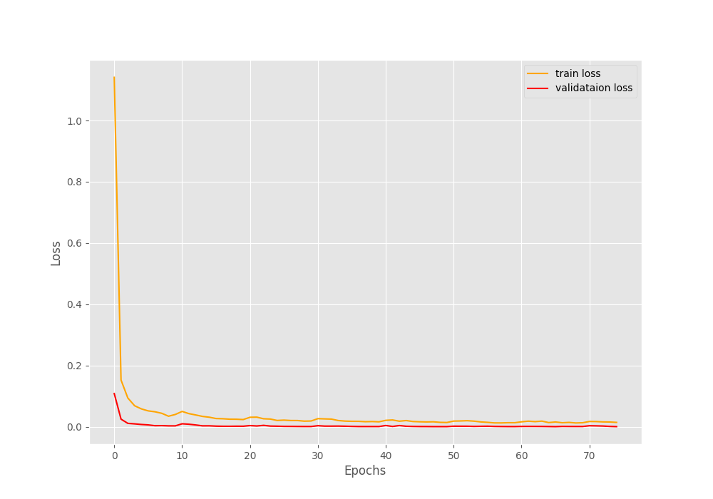
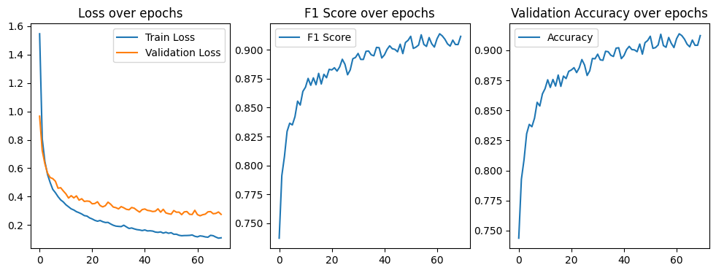
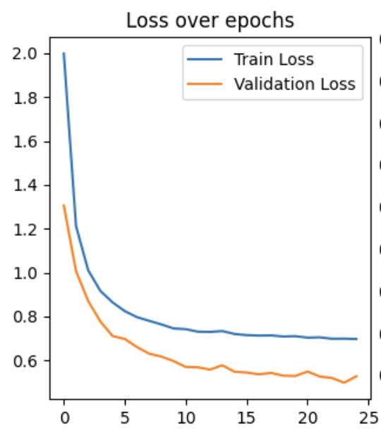
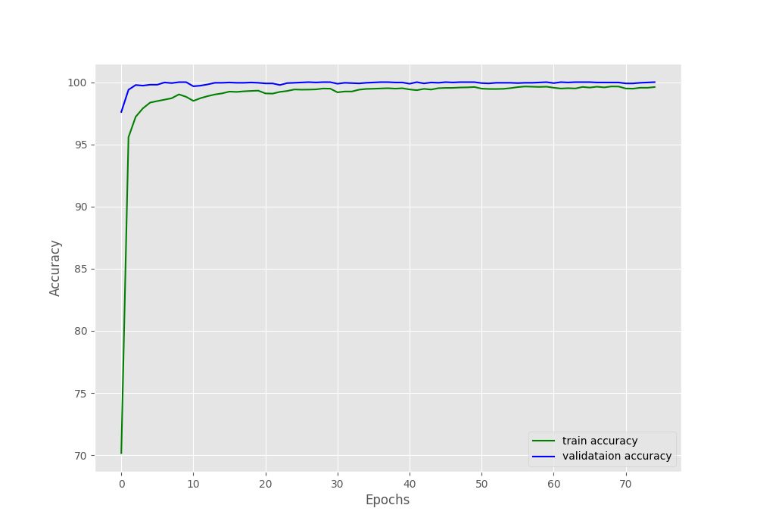
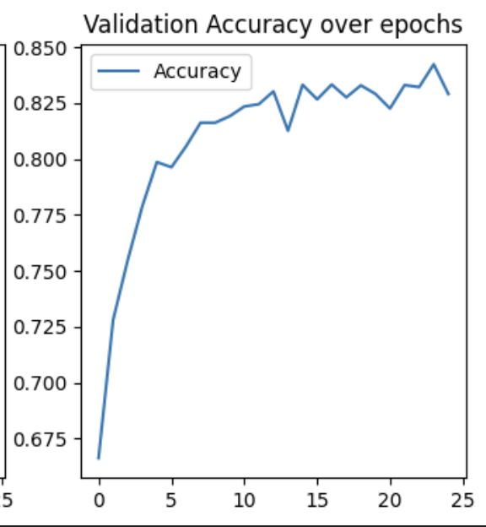
Training and Validation Curves
MobileNetV3:
ResNet50:
InceptionNetV3:
training and validation loss
training and validation loss
training and validation loss
training and validation accuracies
validation accuracy
validation accuracy

Slide 9
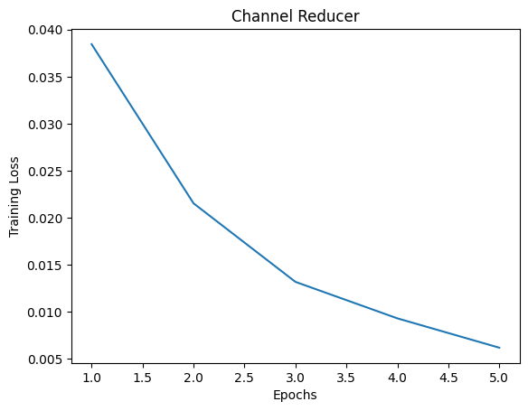
Solution Space (MobileNetV3)
Concatenate edge image and normal image before performing inference
Expand 3 channel image to 4 channel and pass through fine tuned model
See if model can’t already judge augmented inputs with its current weights
Trained a simple CNN (one layer) to convert 4 channels into 3
Used training data to create pairs of canny edge maps as the input, the original image as the label
5 epochs, MSE Loss, LR = 0.001

Slide 10


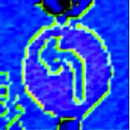
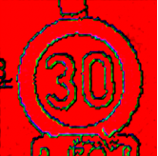

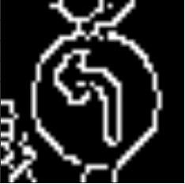
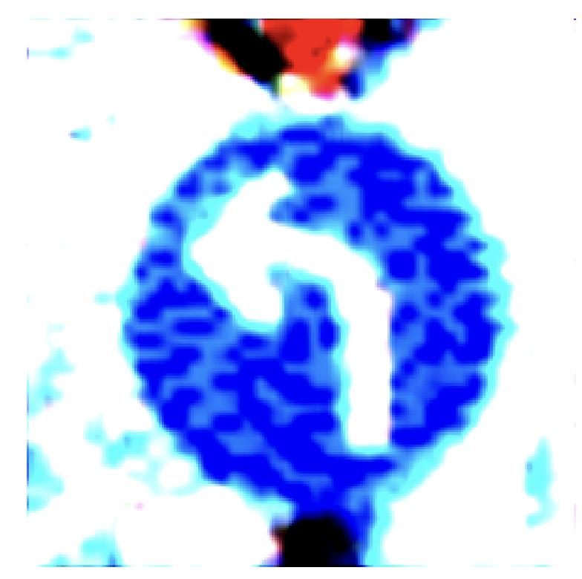
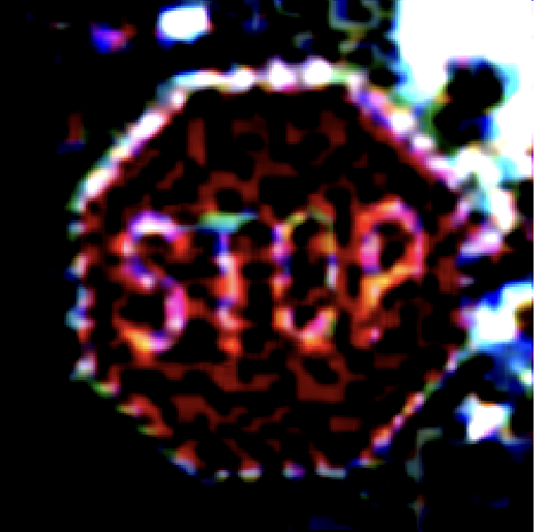
Solution Space (MobileNetV3)
Perturbed Data with FGSM attack
Reducing from 4 channels to 3 channels with random CNN weights
Canny images on perturbed data
Reducing from 4 channels to 3 channels with trained CNN

Slide 11
Solution Space (MobileNetV3)
 | Test Accuracy | F1 Score
Baseline with FGSM Attack | 97.35% | 0.986
With Canny Edge and trained CNN | 75.76% | 0.82
With Canny Edge and random CNN weights | 30.48% | 0.29
 | Test Accuracy | F1 Score
Baseline with Gaussian Blur Attack | 89.61% | 0.92
With Canny Edge and trained CNN | 86.726% | 0.897
 | Test Accuracy | F1 Score
Baseline with PGD Attack | 77.27% | 0.84
With Canny Edge and trained CNN | 81.42% | 0.86
Notes:
89.61%

Slide 12
Solution Space (MobileNetV3)
Denoising/Deblurring using MPRNet (off-shelf)
Intuitively, if FGSM and PGD add the noise to the image, then denoising those images should reverse noise addition. Similarly, deblurring should reverse the effects of Gaussian Blur
MPRNet was chosen because it utilizes multiple stages to progressively restore the image focusing on different aspects of restoration:
1) Encoder – Decoder Network: large receptive fields essential for understanding the overall image context.
2) Original Resolution Network: preserve the fine details necessary for high-quality restoration.
3) SAM: Supervised Attention Module (SAM) is used between each stage to refine the processed features is used to guide the attention mechanism
4) CSFF: Cross Stage Feature Fusion Technique, that ensures that integrates the features from different stages preventing the loss in details
Denoising/Deblurring using MPRNet + contrast enhancement
After inspecting some images, it was noted that some images might not have defined sign boundaries that blend in with environment, so contrast enhancement was introduced.

Slide 13
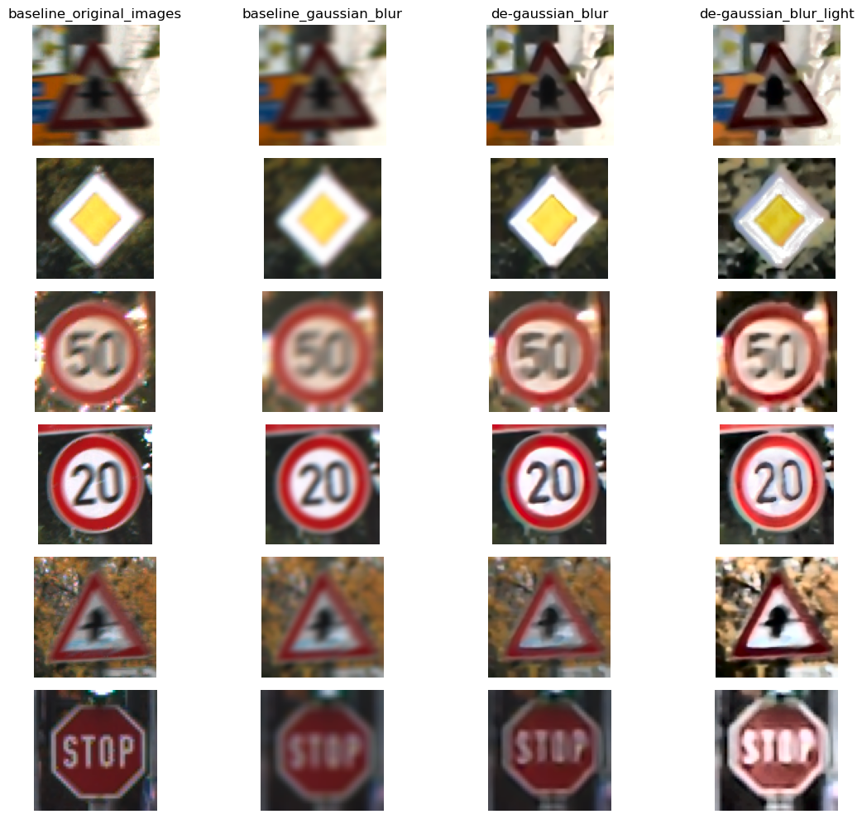

Slide 14
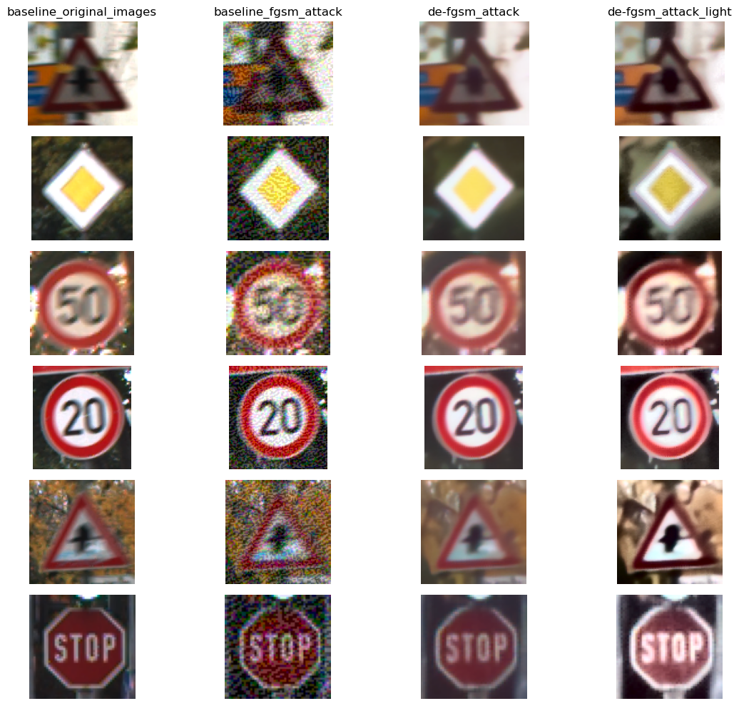

Slide 15
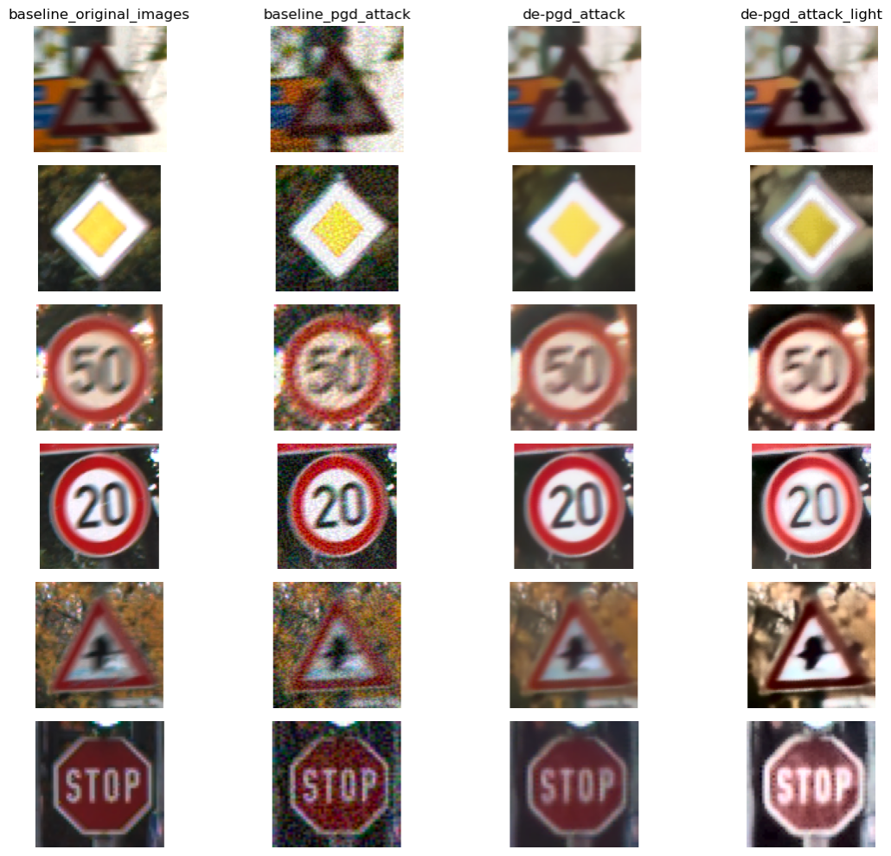

Slide 16
Test accuracies on 3810 images on the selected classes (0,1,2,11,12,14,16,28,34,35,39)
Image Set | Test Accuracy | F1 Score
Original Images | 99.30% | 0.9953
Gaussian Blur Baseline | 89.61% | 0.9196
Deblurred (MPRNet) | 87.74% | 0.8998
Deblurred (MPRNet) + Contrast enhancement | 88.35% | 0.8836
FGSM Baseline | 67.14% | 0.7540
Denoised FGSM (MPRNet) | 78.11% | 0.8566
Denoised FGSM (MPRNet) + Contrast enhancement | 82.23% | 0.8737
PGD Baseline | 77.27% | 0.8431
Denoised PGD (MPRNet) | 83.76% | 0.8953
Denoised PGD (MPRNet) + Contrast enhancement | 87.16% | 0.9115

Slide 17
Solution Space (MobileNetV3)
Manual clustering and pseudo-denoising based on k-Means clustering
Why?
From previous experiments the denoising approach improved the test accuracy on the PGD and FGSM images.
How?
Empirically determined most optimal k value = 5 that corresponds to number of most dominant colors in the image.
Segment the images based on 5 dominant colors
For each segmented group (not color, since there will be multiple groups for the same color):
Average the pixel values on the adversarial image for each group
Replace the values of that group with an averaged value

Slide 18
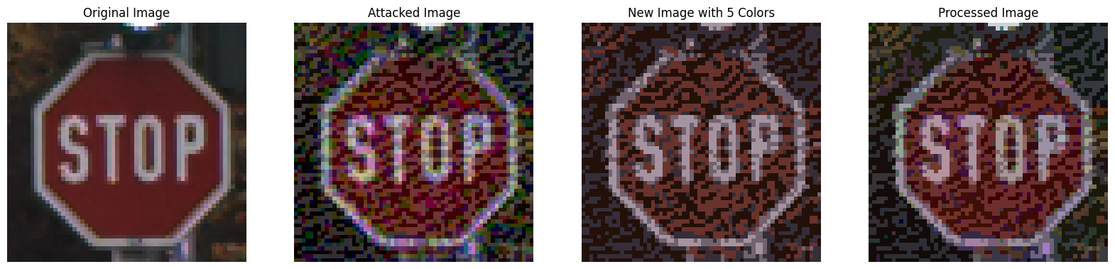
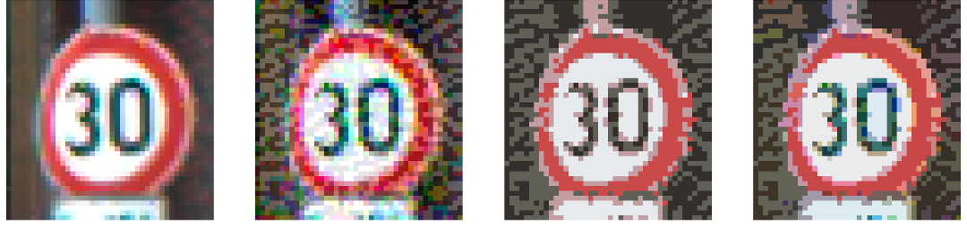
Solution Space (MobileNetV3)
Color Averaging: pseudo-denoising based on k-Means clustering

Slide 19
Test accuracies on 3810 images on the selected classes (0,1,2,11,12,14,16,28,34,35,39)
Image Set | Test Accuracy | F1 Score
Original Images | 99.30% | 0.9953
Original Images + Color Averaging | 95.88% | 0.9708
Gaussian Blur Baseline + Color Averaging | 72.89% | 0.7766
Deblurred (MPRNet) + Color Averaging | 79.11% | 0.8344
Deblurred (MPRNet) + Contrast enhancement + Color Averaging | 80.34% | 0.8412
FGSM Baseline + Color Averaging | 69.19% | 0.7677
Denoised FGSM (MPRNet) + Color Averaging | 70.76% | 0.7875
Denoised FGSM (MPRNet) + Contrast enhancement + Color Averaging | 70.84% | 0.7719
PGD Baseline + Color Averaging | 78.85% | 0.8498
Denoised PGD (MPRNet) + Color Averaging | 77.09% | 0.8384
Denoised PGD (MPRNet) + Contrast enhancement + Color Averaging | 76.38% | 0.8178

Slide 20
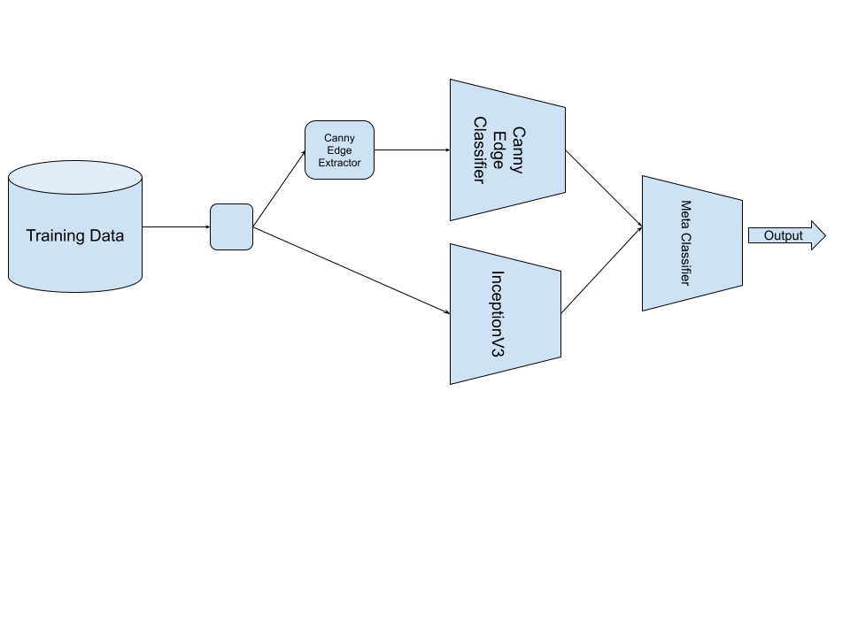
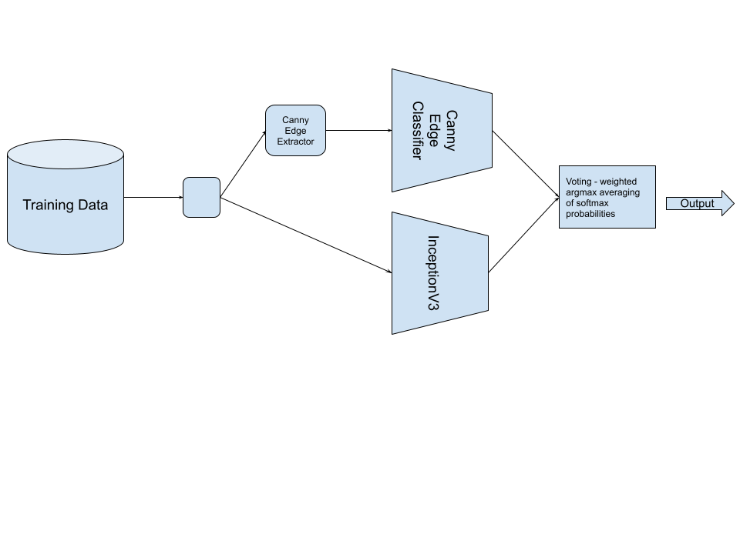

Solution Space (InceptionV3)
Stacking/Ensembling classifiers for edge image and normal image
Weighted voting - averaging the softmax probabilities from both and applying a weighting based on which classifier is better performant
Training a meta-classifier - overall neural network that has the independent image networks as sub networks

Slide 21
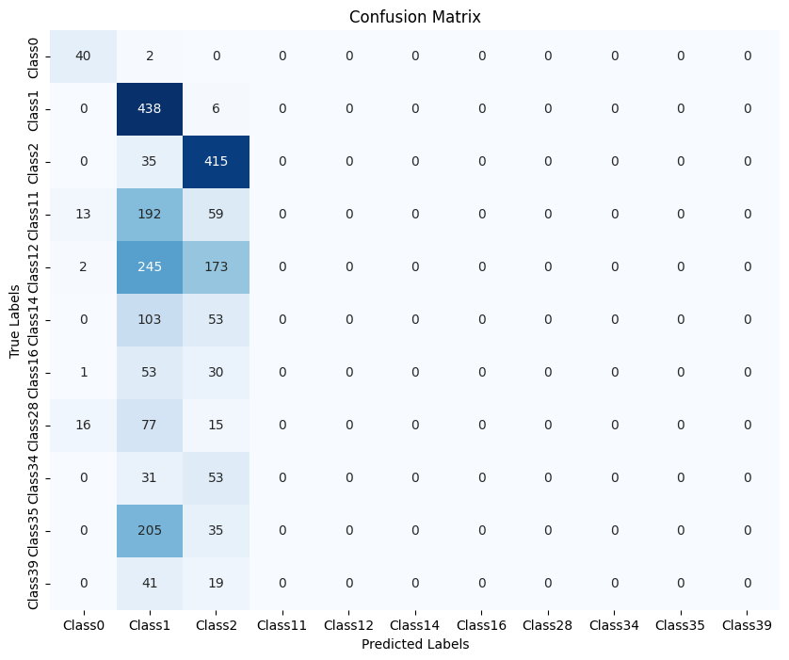
Stacking/Ensembling failed - worse than random guessing ~ 45% accuracy
Canny Edge classifier had poor performance
Quality of edge extracted images for a lot of classes was poor - no edges detected

Slide 22
Results & Conclusion
Given the results, it is clear that FGSM had the most impact (32.16% drop) on the baseline test accuracy, then PGD (22.03% drop) and then Gaussian Blur (9.69% drop).
Gaussian Blur:
Deblurring and Contrast Enhancement did not significantly changed the test accuracy (fluctuates within ~1%).
Canny Edge Concatenation did not significantly change the test accuracy (fluctuates within 3.22%)
FGSM:
Denoising improved test accuracy by 10.97% & F1 score improved by around 0.1
Contrast enhancement improved accuracy by 4.12% and F1 score improved by 0.12
Canny Edge Concatenation decreased test accuracy by 22.17% & F1 score decreased by 0.16
PGD:
Denoising improved test accuracy by 6.49% and F1 score improved by 0.05
Contrast enhancement improved accuracy by 3.4% and F1 score improved by 0.07
Canny Edge Concatenation improved accuracy by 5.37% and F1 score improved by 0.02
Techniques such as color contrast, ensembling were not successful mitigation techniques

Slide 23
Results & Conclusion
Gaussian blur attacks are the most difficult to protect against at inference time
Black box attacks are more difficult to protect against
Multiple techniques were able to improve accuracy on a PGD attack
Maybe it was a milder attack than FGSM (not entirely sure)
The de-noising and contrast enhancement were effective against FGSM but canny edge concatenation was not
De-noising is directly combatting FGSM while canny edge is not
Future works include:
Combining the successful mitigation techniques
Trying ensemble methods with features other than canny edge
Trying with a different dataset to ensure that results are consistent
Try mitigation techniques on various strengths of attacks
It’s difficult to improve performance on inference time alone, but not eager to rule it out

Slide 24
Thank you!
Thank you to our Professors and TA mentor, Weiran, for all your help and guidance!

Slide 25
Resources
[1] Bassett, R. (2021). Color and Edge-Aware Adversarial Image Perturbations.
[2] Hosseini, H., Xiao, B., & Poovendran, R. (2019). n-ML: Mitigating Adversarial Examples via Ensembles of Topologically Manipulated Classifiers.
[3] Shafahi, A., Najibi, M., Ghiasi, A., Xu, Z., Dickerson, J., Studer, C., ... & Goldstein, T. (2019). Adversarial training for free!
[4] Zamir S., Arora A., et al., (2021). CVPR. Multi-Stage Progressive Image Restoration.
[5] Rath S. (2022), Traffic Sign Recognition using PyTorch and Deep Learning. Debugger Cafe. https://debuggercafe.com/traffic-sign-recognition-using-pytorch-and-deep-learning/
[6] Color-Extraction-and-Image-Segmentation.(2020). https://github.com/Ronny-22-Code/Color-Extraction-and-Image-Segmentation.git

